Slide 1
Barriers to Implementing a Just Culture
By: Jackson Webster
CSD-380

Slide 2

What is a Just Culture?
Instead of blaming people right away, they try to:
Understand why something went wrong
Fix system problems
Help people learn from mistakes
This helps workers feel safe reporting problems so things can improve.

Slide 3

Why is Just Culture Important
Just Culture is important because:
People are more honest about mistakes
Problems get fixed faster
Safety improves
Workers feel respected
Without Just Culture, people may hide mistakes because they’re scared of getting in trouble.

Slide 4

Main Barriers & Challenges
Some big challenges to using a Just Culture are:
Fear of punishment
Lack of leadership support
Poor communication
Resistance to change
Confusing rules
These make it harder for workers to trust the system.

Slide 5

Fear of Punishment
One of the biggest problems is fear.
Workers may:
Be scared of getting fired
Worry about getting blamed
Avoid reporting mistakes
This makes problems harder to fix.

Slide 6

Leadership & Organization Problems
Sometimes leaders:
Don’t fully support Just Culture
Still blame workers
Care more about punishment than learning
If leaders don’t support it, workers won’t trust it.

Slide 7
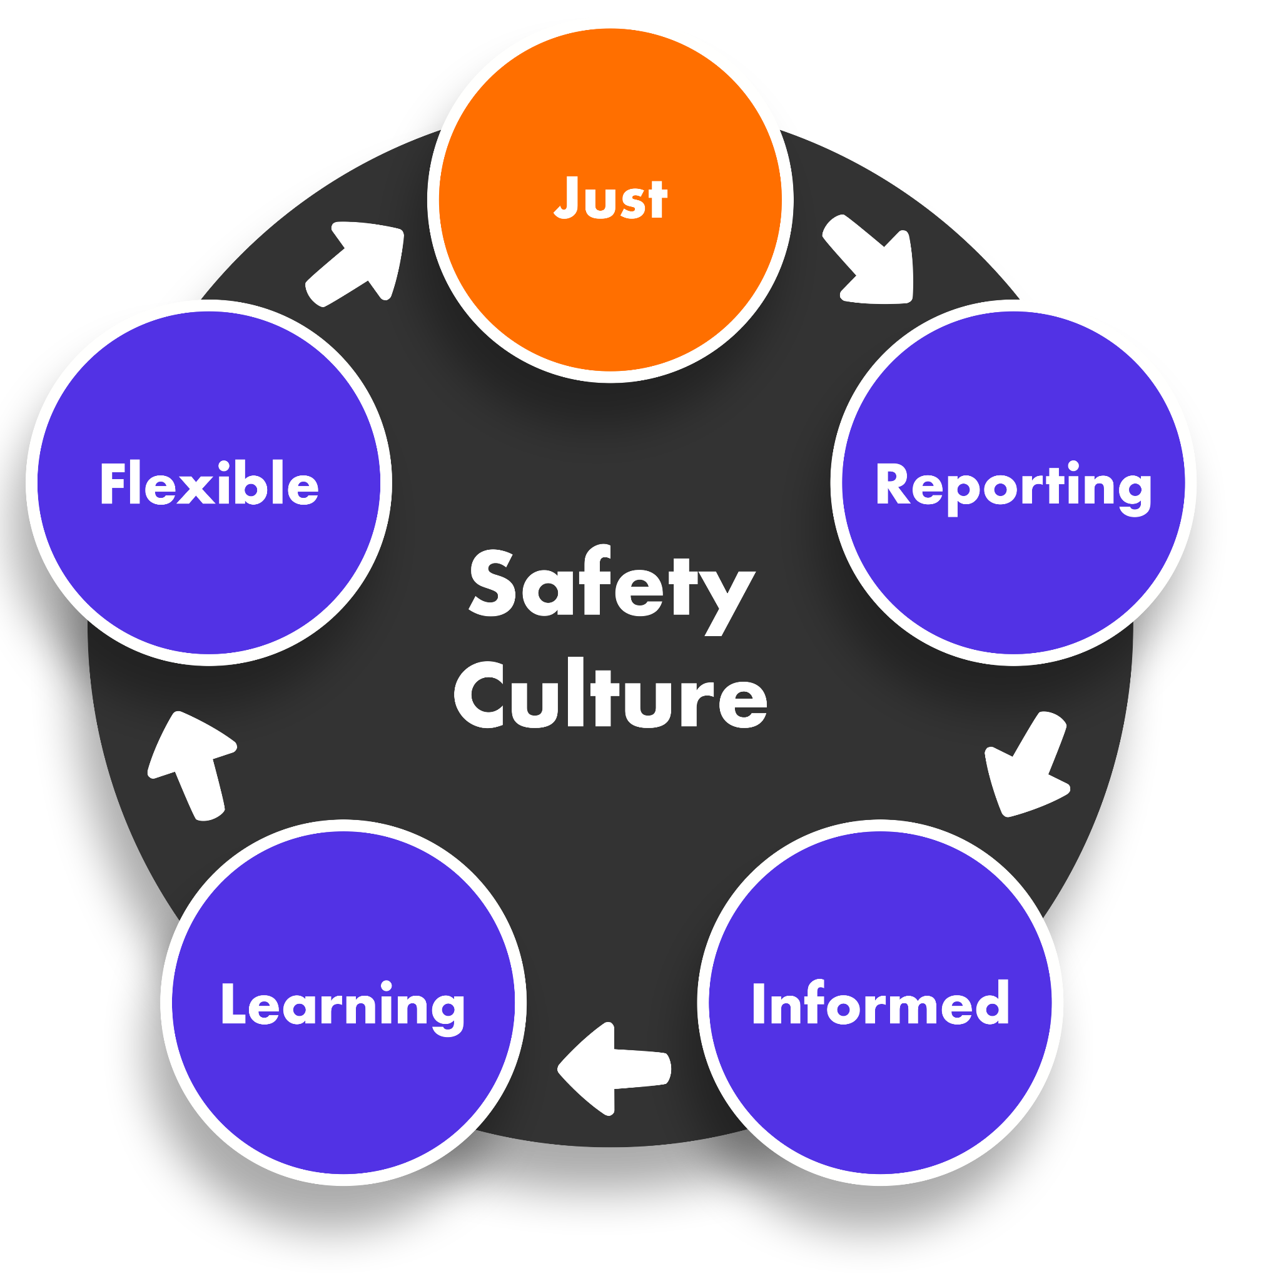
Barriers to Just Culture

Slide 8
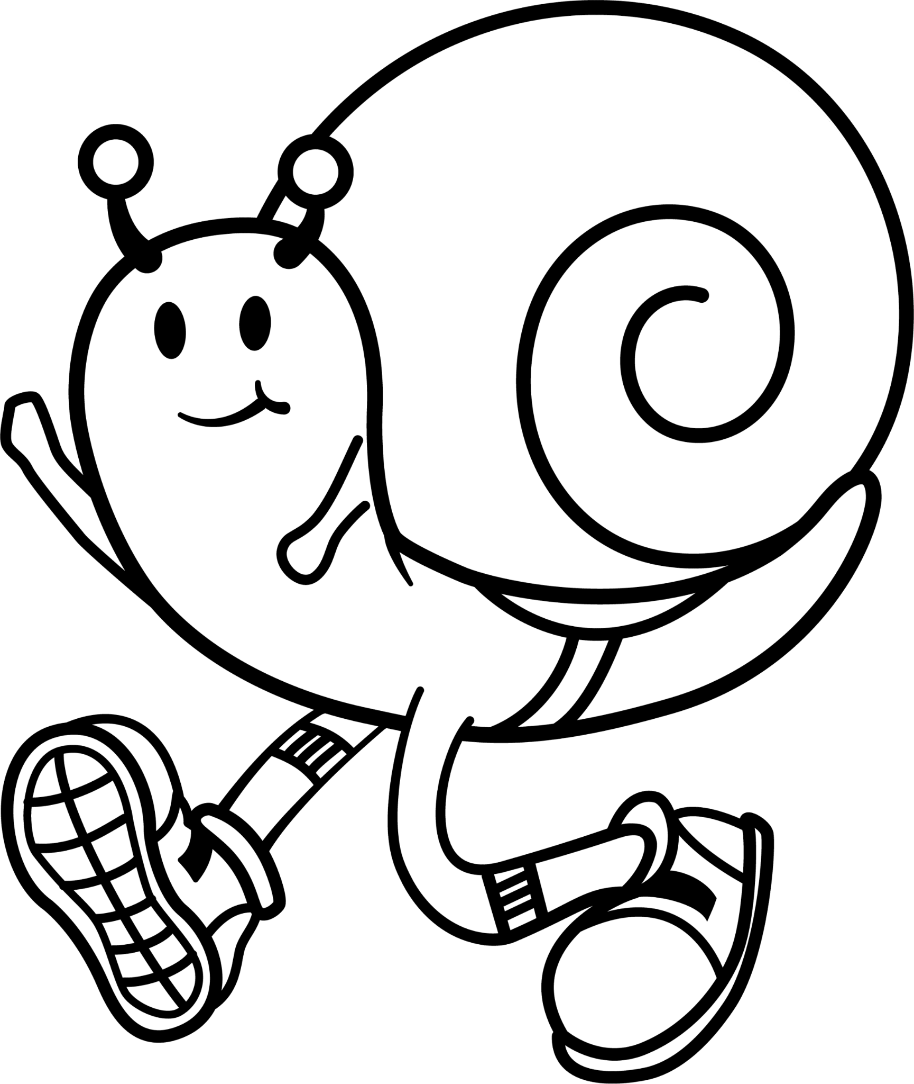
Conclusion
Just Culture helps make workplaces safer and fairer.
But it can be hard to use because:
People are afraid
Leaders don’t always support it
Change is difficult
With better leadership, trust, and training, organizations can successfully use Just Culture.

Slide 9
References
National Library of Medicine / PubMed (NIH – U.S. Government)
Just Culture in Healthcare Settings: A Review of Implementation Practices https://pubmed.ncbi.nlm.nih.gov/40992773/
National Library of Medicine / PubMed (NIH)
Barriers and Trust in a Just Culture – Systematic Review https://pubmed.ncbi.nlm.nih.gov/35588066/
Oxford Academic – Military Medicine Journal
Just Culture: Shifting Organizational Mindset https://academic.oup.com/milmed/article/185/Supplement_3/52/5916455

